Slide 1
简单图像特效

Slide 2
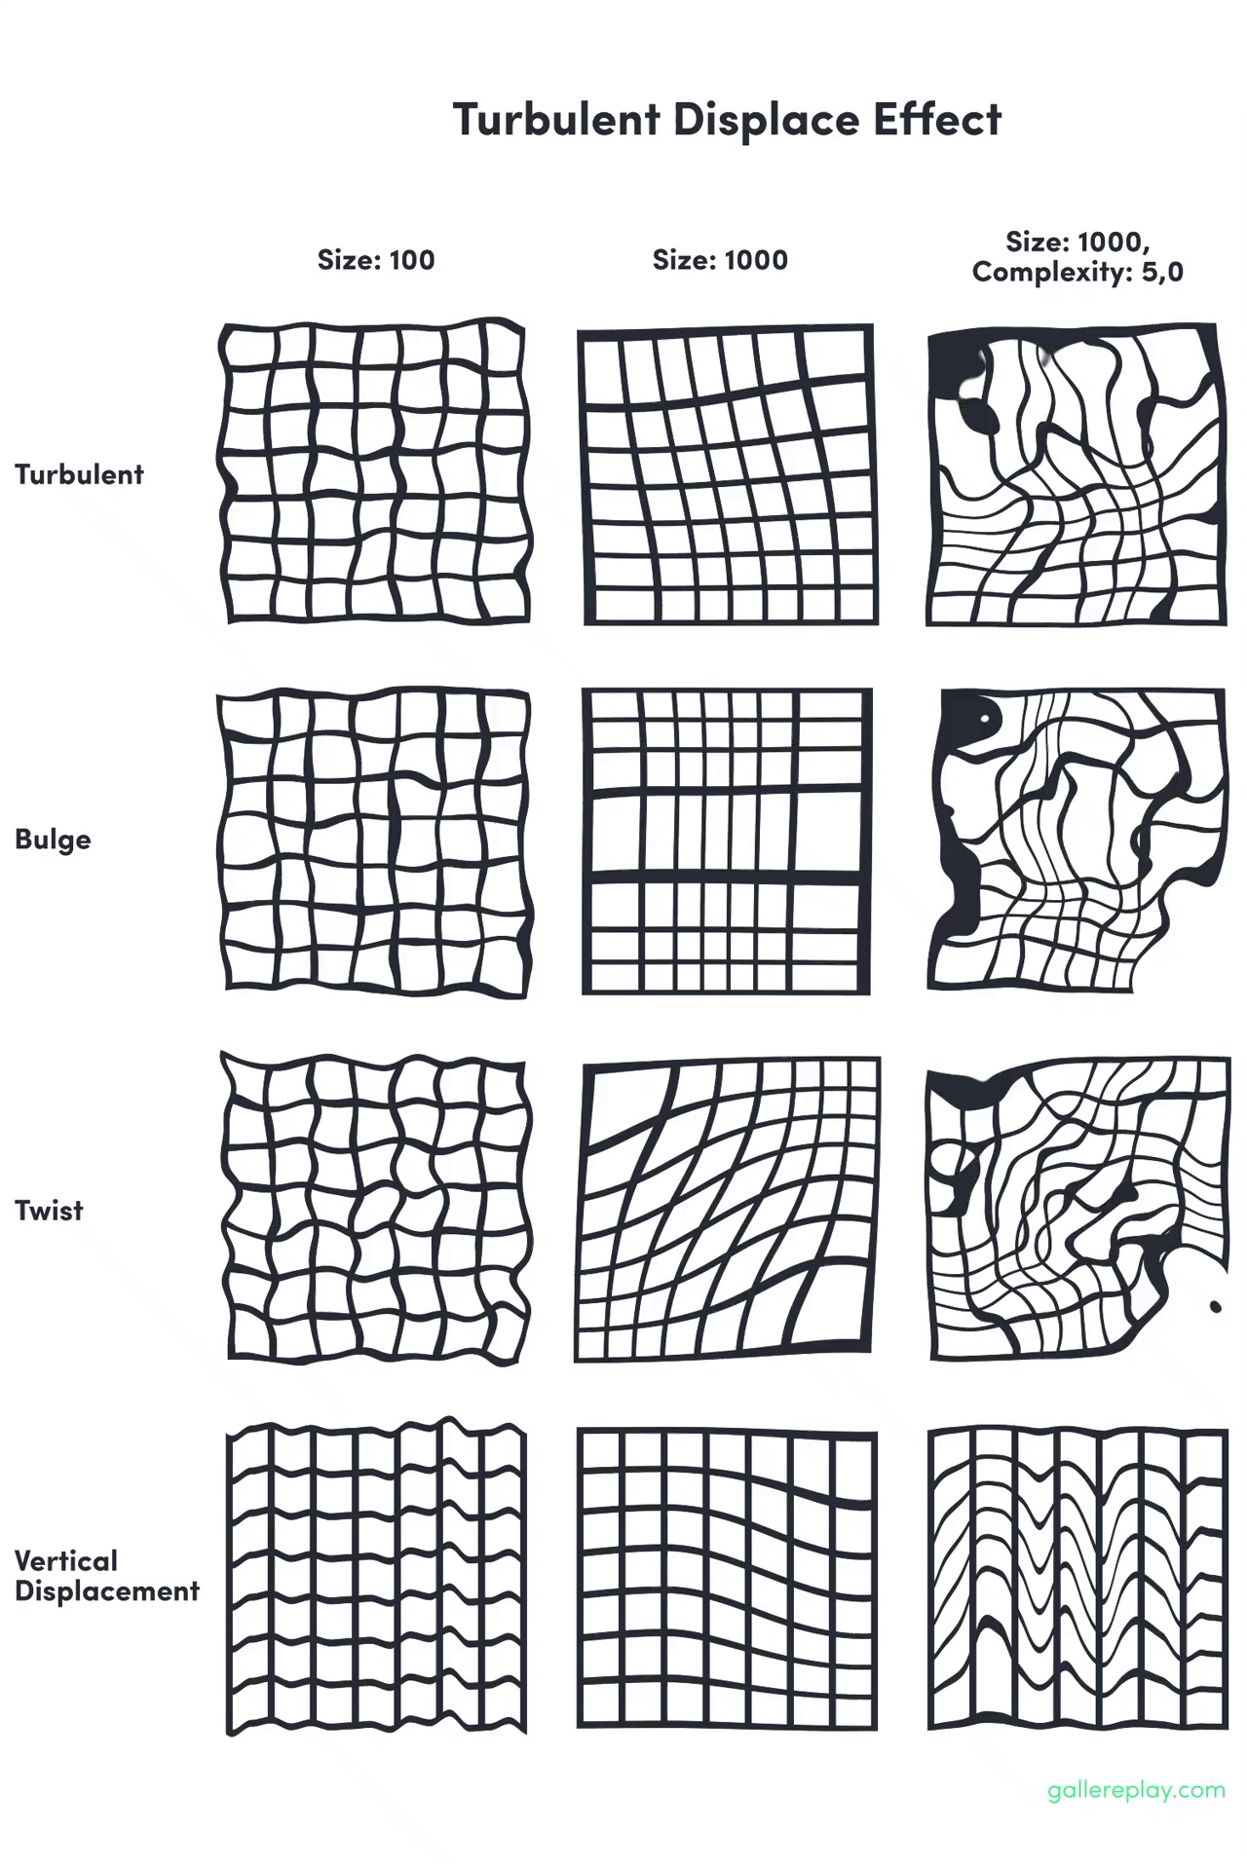
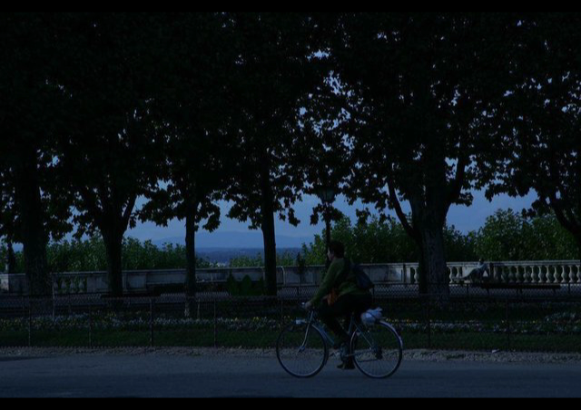

Slide 3
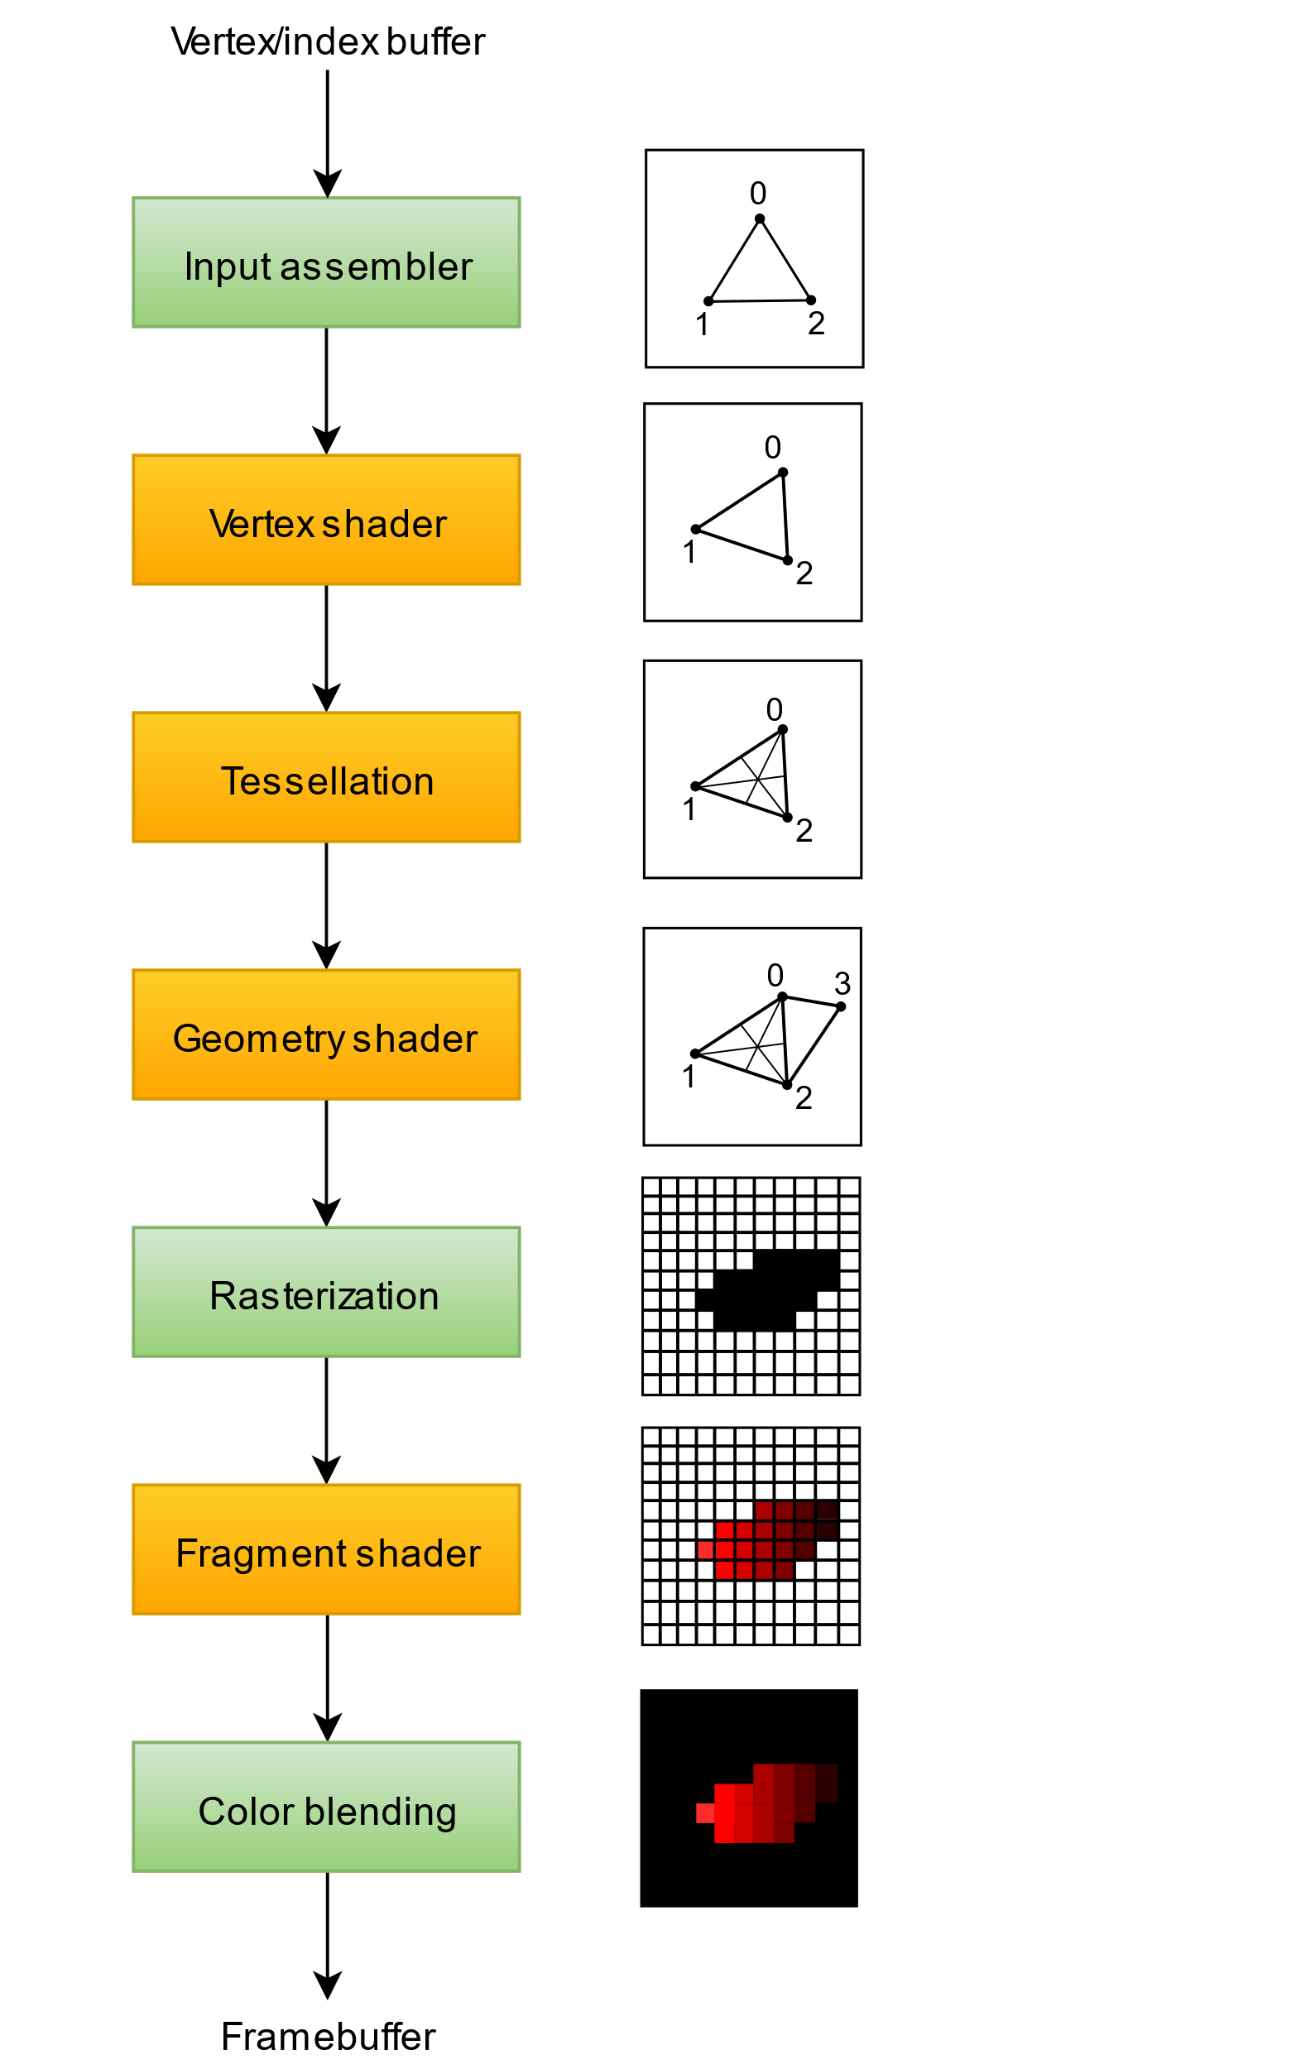
基本的渲染管线

Slide 4
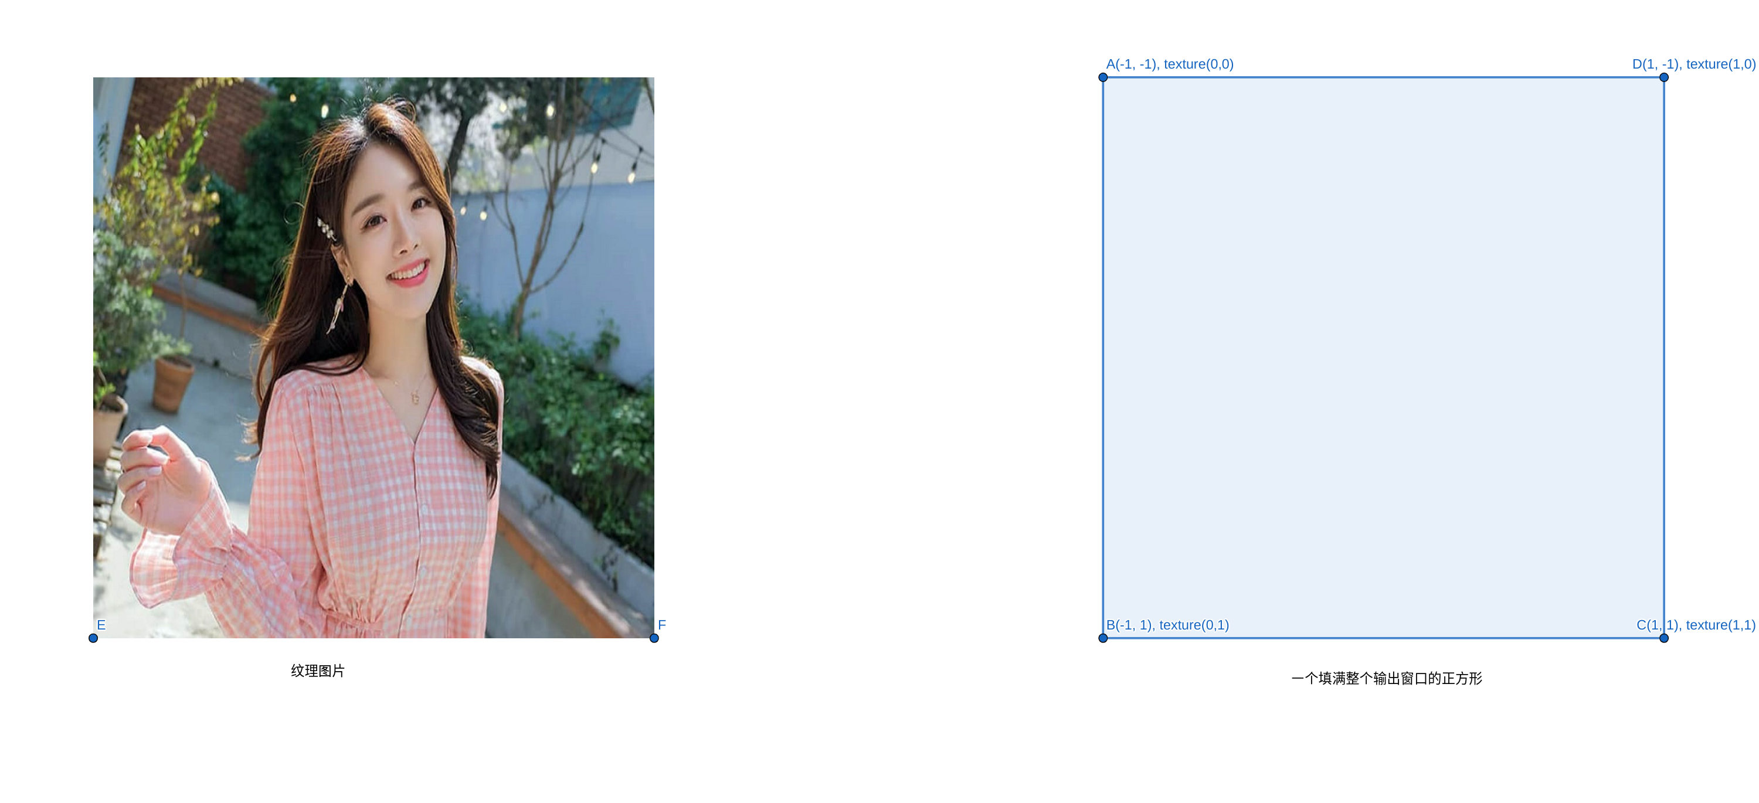
一帧图像渲染

Slide 5
一帧图像渲染
void main()
{
vec2 uv = (gl_FragCoord.xy / iResolution.xy);
vec4 color = texture(iChannel0, uv);
gl_FragColor = color;
}

Slide 6
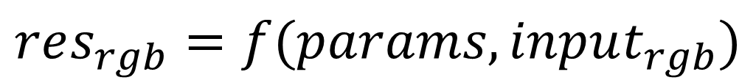
曝光调整滤镜
Exposure
Simulates the exposure setting on the camera that captures the image, multiplying all light intensity values by a constant. The units for Exposure are f-stops.
Offset
Darkens or brightens the shadows and midtones with minimal change to the highlights.
Gamma Correction
The amount of gamma correction to use for adding an additional power-curve adjustment to the image. Higher values make the image lighter; lower values make the image darker. Negative values are mirrored around zero (that is, they remain negative but still get adjusted as if they were positive). The default value is 1.0, which corresponds to no additional adjustment.
$$res_{rgb}=f(params, input_{rgb})$$

Slide 7
曝光调整滤镜
float apply_offset(float x, float y)
{
…
}
void main() {
vec2 uv = (gl_FragCoord.xy / iResolution.xy);
vec4 color = texture(iChannel0, uv);
// offset
color.x = apply_offset(color.x, offset);
color.y = apply_offset(color.y, offset);
color.z = apply_offset(color.z, offset);
// exposure
color.xyz = color.xyz*exp(0.289275662274758*exposure);
// gamma
color.x = pow(color.x, 1.0/gamma);
color.y = pow(color.y, 1.0/gamma);
color.z = pow(color.z, 1.0/gamma);
gl_FragColor = color;
}

Slide 8
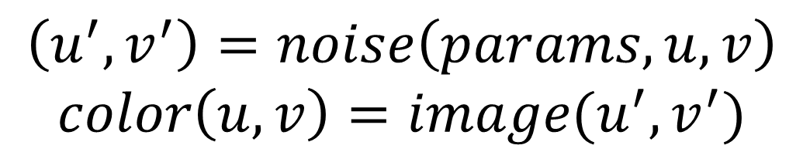
湍流置换
其本质是一个计算像素位置偏移的函数:
$$\left(u^{′}, v^{′}\right)=noise\left(params, u,v\right)$$
$$color\left(u,v\right)=image(u^{′}, v^{′})$$

Slide 9
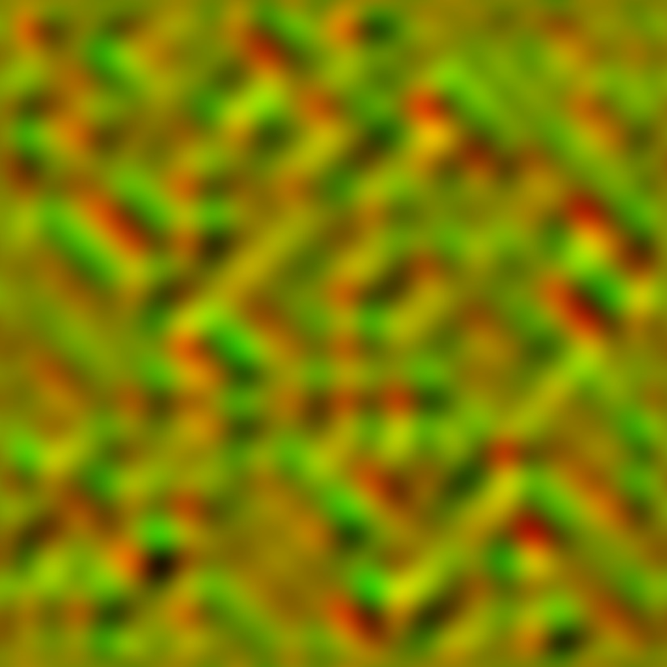
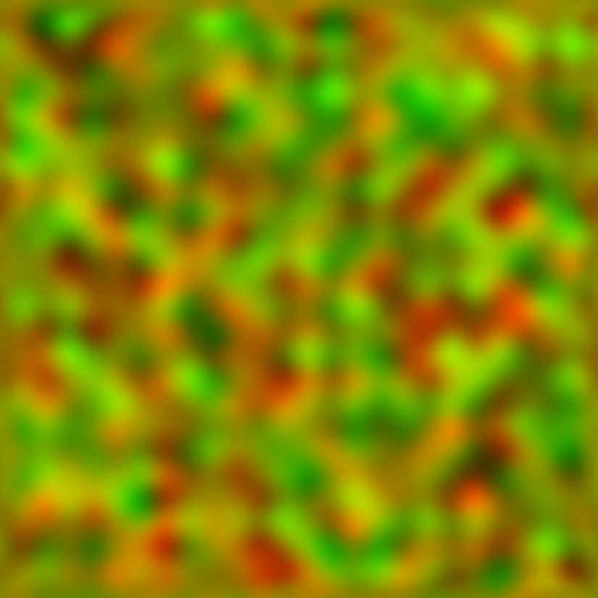
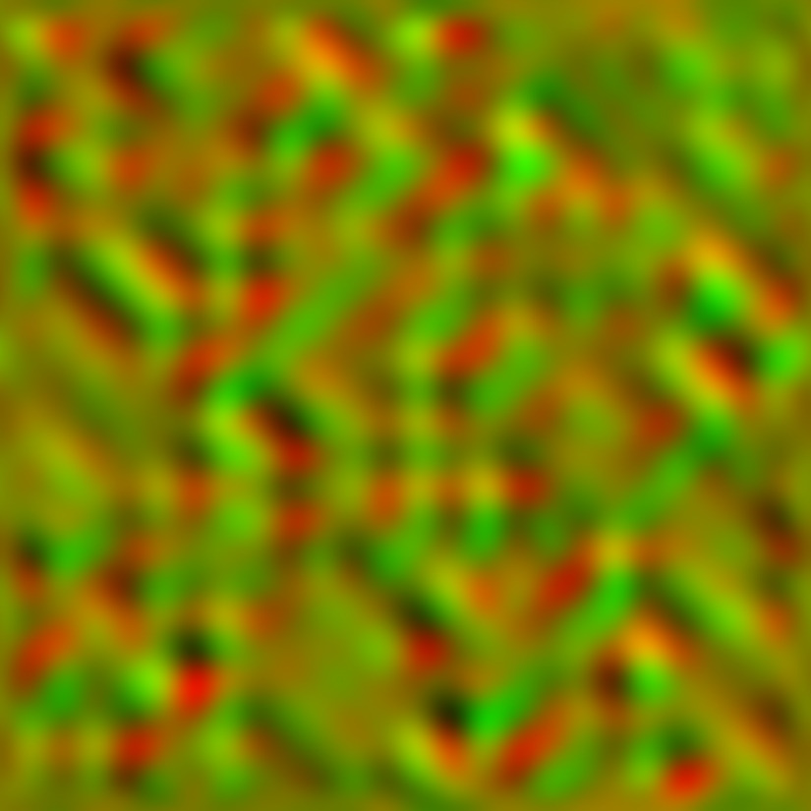
湍流置换
不同的噪声, 得到不同类型的效果:
bulge
turb
twist

Slide 10
Thanks!

